Slide 1
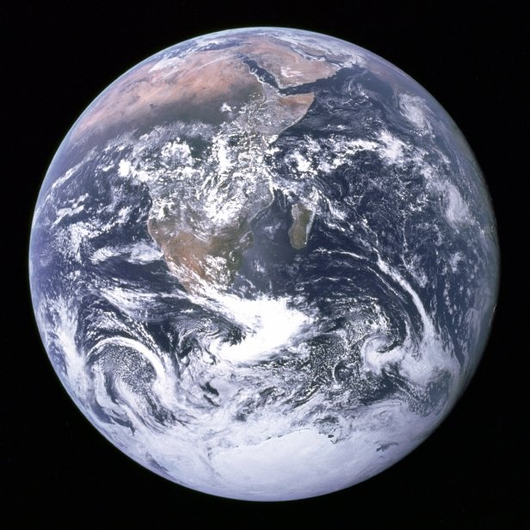

Slide 2
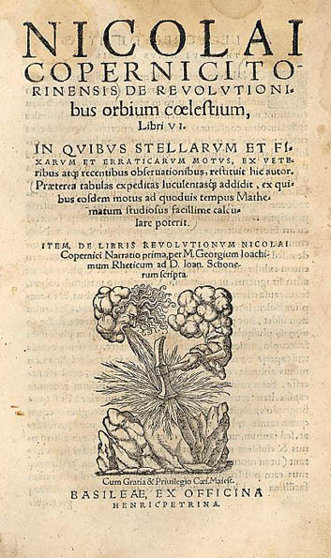
1543: Scientific Revolution Begins
Notes:
Nicolai Copernicus publishes his De Revolutionibus Orbium Coelestium (On the Revolutions of Celsetial Bodies)
Andreas Vesalius publishes his De Humani Corporis Fabrica (On the Structure of the Human Body)

Slide 3
From Geo- to Helio-centrism

Slide 4
The Copernican Revolution: Three Meanings
Literal meaning: Copernicus’s own work.
2. As a synonym for the Scientific Revolution:
In this view, SR is more like a relay race in which the torch lit by Copernicus is passed on through Kepler and Galileo finally to Newton.
3. As a metaphor for radical change in ideas, ideas that turn the work upside-down, or inside-out.

Slide 5
Nicolas Copernicus (1473-1543)
Notes:
A portrait painted around 1580, after his death.

Slide 6
Notes:
N. Copernicus’s childhood home, in Torun, Poland. now a museum

Slide 7
Frauenburg Cathederal

Slide 8
Copernicus’s tower at the cathederal

Slide 9
The Commentariolus (Or the Brief Sketch), 1510.
Assumptions:
The Earth is not at the center of the universe
Sun is at the center
The Earth MOVES
Twirls On its axis, once every day. This explains the daily motion of the fixed stars
Goes around the Sun, once in a year. This explains the year.
Wobbles on the poles. This explains the tilt along the axis. .

Slide 10
The Commentariolus (Or the Brief Sketch), 1510.
“ The center of the Earth is not the center of the universe, but only the center toward which heavy things move and the center of the lunar sphere”
“ all spheres surround the Sun, as though it were in the middle of all of them, and therefore the center of the universe in near the sun”
“What appears to us as motion of the Sun arise not from its motion but from the motion of the Earth and our sphere, with which we revolve around the Sun like any other Planet.”

Slide 11
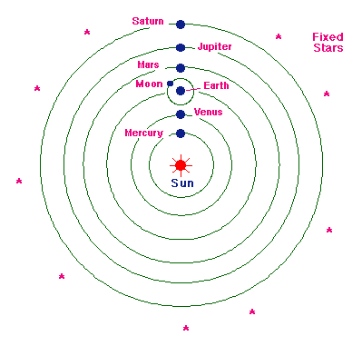
The “problem of the planets” is solved
No equant points
Epicycles stay:” mercury runs on 7 circles
Venus on 5, earth on 3, around it the moon on
4, Mars, Jupiter and saturn on 5 each. All together,
34 circles suffice to explain the … ballet of the planet
4.
A modern sketch Copernican model

Slide 12
Using a triquetrum

Slide 13
Georg Joachim Rheticus (1514-1574)

Slide 14
De Revolutionibus Orbium Coelestium

