Slide 1
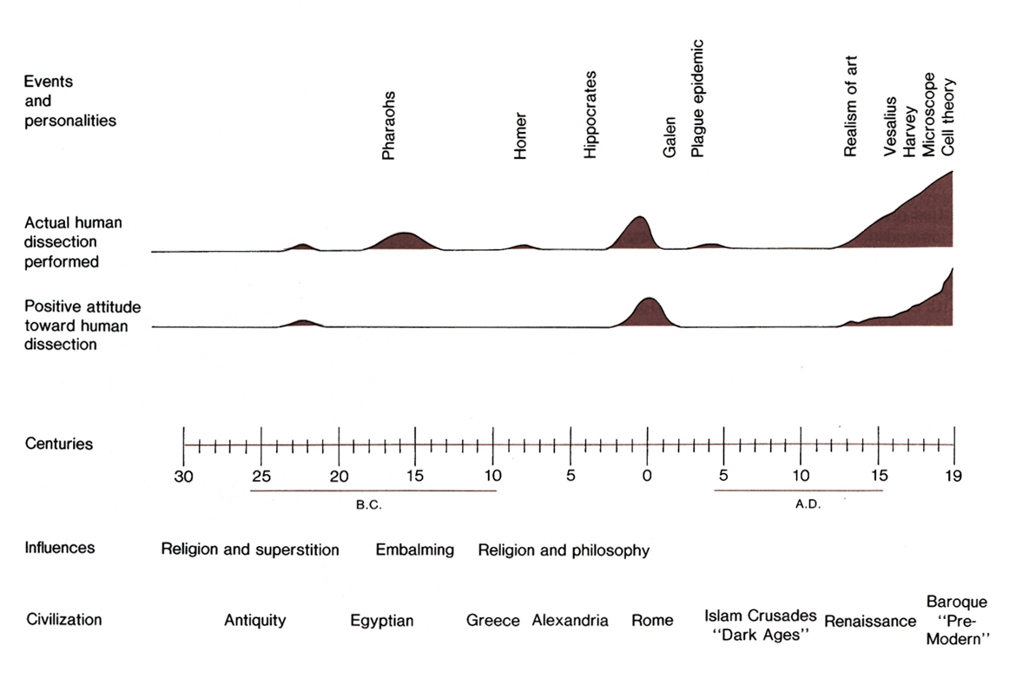
Anatomical Time Line
Empedocles
Hippocrates
Aristotle
Herophilus
Erasistratus
Galen
Empedocles
Mondino
Imhotep

Slide 2
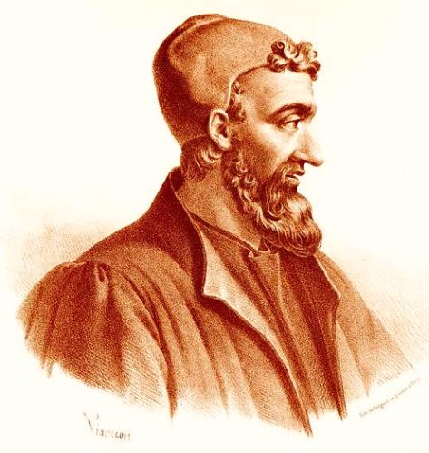
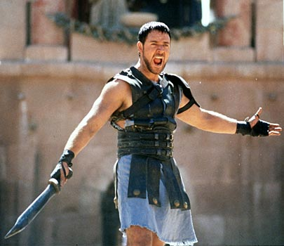
Chronology of Galen’s Life
Russel Crowe in Gladiator
Born near Pergamon
144 – 152 Studied anatomy in Pergamon, Smyrna, Alexandria
157 Appointed physician to the gladiators in Pergamon
168 Appointed physician to Marcus Aurelius
Appointed Physician to Commodus
200 Died in Pergamon
Notes:
http://en.wikipedia.org/wiki/File:Galen_detail.jpg
http://www.nlm.nih.gov/hmd/greek/popup/images/galen_detail.jpg
http://tvtropes.org/pmwiki/pmwiki.php/Film/GLADIATOR

Slide 3
Galen of Pergamon (129 - 200 C.E.)
Greatest influence on medicine for 1400 years
Prolific writer
Over 500 articles (83 exist today)
De anatomicis administrationibus
a dissection manual
De usu Partium
On the Use of the Parts of the Body
Summarized the medical knowledge
before his time
Notes:
http://www.nndb.com/people/788/000087527/galen-sm.jpg

Slide 4
Galen of Pergamon (129 - 200 C.E.)
Greatest influence on medicine for 1400 years
Performed many experiments
Arteries contain blood and not air
Function of recurrent laryngeal nerve
to control vocal cords
Knowledge of anatomy from
wounds of gladiators,
dogs, pigs, sheep, monkeys
Notes:
http://www.nndb.com/people/788/000087527/galen-sm.jpg

Slide 5
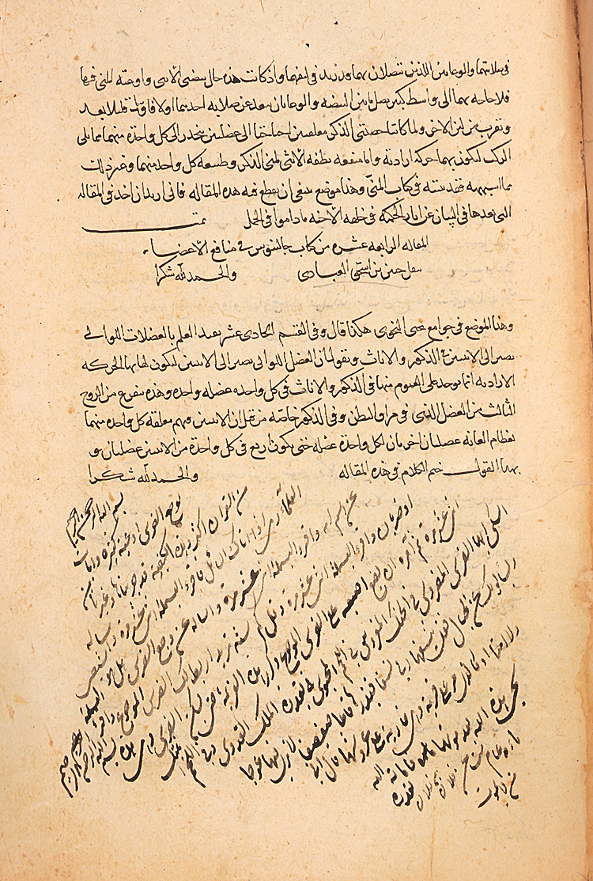
Translation of Galen
Baghdad, 9th century
*
Notes:
A translation of Galen made in Baghdad in 9th cent. Included references to human dissection that provoked no comment, at least among the Christian physicians.
Also, Galen’s On the usefulness of the Parts was translated, including the Design aspects, that became prominent among later Muslim scholars.
Later Muslims often quote Galen on dissection, and no negative comments yet found.
http://www.es.flinders.edu.au/~mattom/science+society/lectures/illustrations/lecture11/galen.jpg
http://www.nlm.nih.gov/hmd/arabic/images/a301209a.jpg

Slide 6
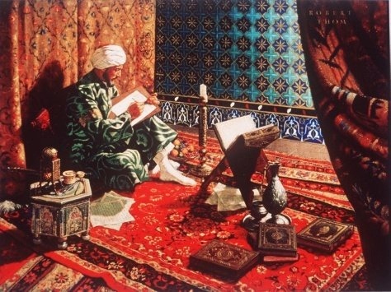
Avicenna (Ibn Sina) of Persia (980-1037 C.E.)
Philosopher and physician
Author of over 200 books
Notes:
http://www.corbisimages.com/images/IX001228.jpg?size=67&uid=%7Ba4050f77-dc4a-4d36-a068-e9dfd5ad0201%7D
http://www.greekmedicine.net/images/Avicenna_at_work.jpg

Slide 7
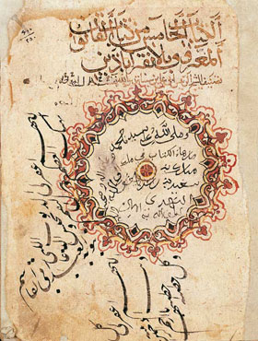
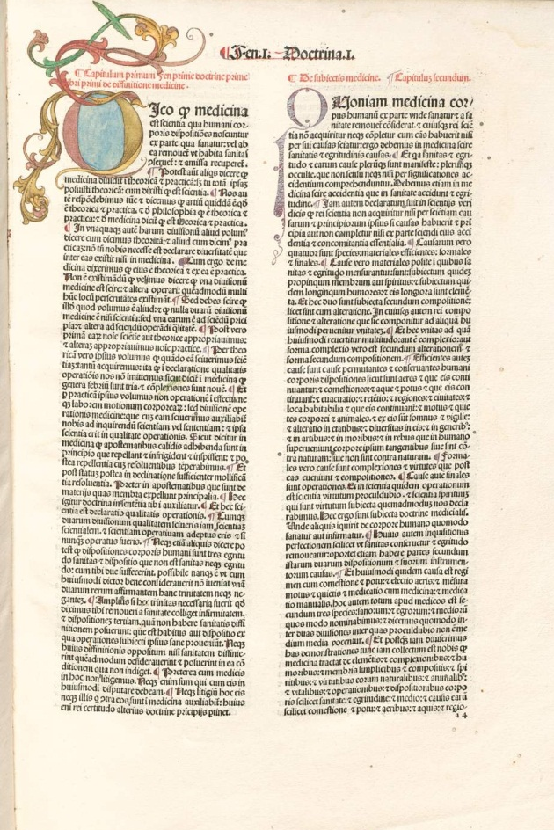
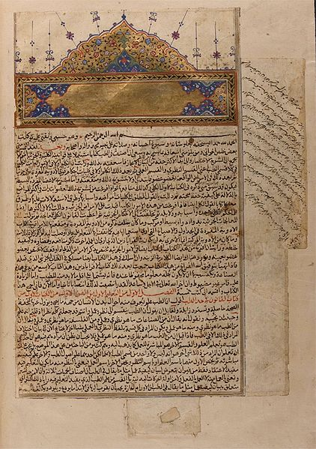
Avicenna’s Canon
One of the most influential medical textbooks ever written
Helped preserve writings of early medical texts
Used in European medical training for over 500 years
1052
1489
1597
Notes:
http://www.akdn.org/museum/img/mission.jpg
http://upload.wikimedia.org/wikipedia/commons/2/23/Avicenna_canon_1597.jpg
http://dfg-viewer.de/show/?set%5Bimage%5D=11&set%5Bzoom%5D=default&set%5Bdebug%5D=0&set%5Bdouble%5D=0&set%5Bmets%5D=http%3A%2F%2Fdaten.digitale-sammlungen.de%2F~db%2Fmets%2Fbsb00045892_mets.xml

Slide 8
Medieval Medical Centers
Padua – 13th c.
Bologna – 11th c.
Salerno – 10th c.
Notes:
http://www.lib.utexas.edu/maps/historical/shepherd/europe_mediterranean_1190.jpg

Slide 9
Anatomical Revolution
Forensic purposes
--First recorded case in Italy, 1286, disease in hens and humans
-- causes of death, by 1300.
Religious purposes:
-- saints bodies had signs of god.
Educational purposes:
-- What is the human norm??
By mid- 1300s, it became compulsory for med students in U. of Padua and Florence to have observed dissections.

Slide 10
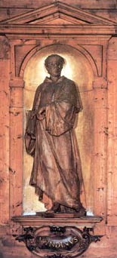
Mondino de Luzzi (1270-1326) “Restorer of Anatomy”
Introduced public dissections of human
cadavers in Bologna – 1316
Wrote Anathomia corporis humani – 1316
(now known as Mondino’s Anatomy)
practical manual of dissection based on
Galenic writings and Mondino’s dissections
principle book on anatomy for 200 years

Slide 11
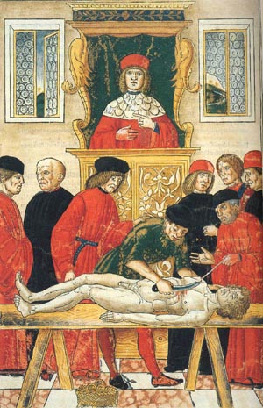
Dissection: Teaching from the Book
Johannes de Ketham
Fasciculo di medicina (1493)
Notes:
http://honors.nmsu.edu/weamon/ketham2.jpg
Other photos: Charleen Moore

Slide 12
Mondino de Luzzi (1270-1326)
What Mondino got wrong
Five lobed liver
(although Mondino said “these five lobes are not always parted”)
Uterus divided into seven cells
Presence of veins connecting uterus to breast to convert menstrual
blood into milk
Rete mirabile at base of brain
Heart had three ventricles
(after Aristotle)

Slide 13
Mondino de Luzzi (1270-1326)
Mondino named many structures,
e.g., parts of the small bowel
Ileum “located at the site near the iliac bone”
Jejunum (L. empty) “you find it generally empty in healthy persons”
Duodenum (following the name given by Herophilus)
“its length is twelve fingers in the majority of cases”

Slide 14
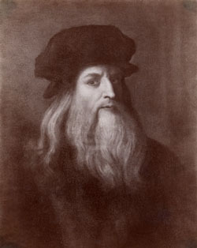
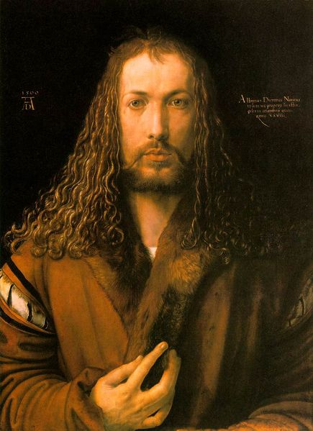
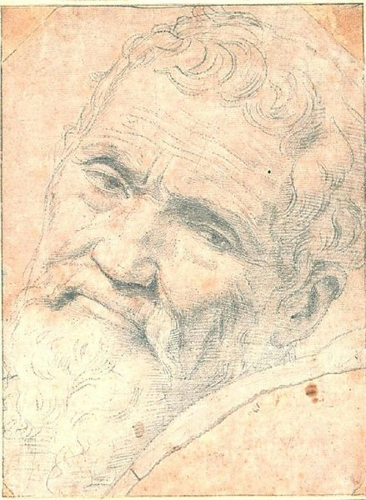
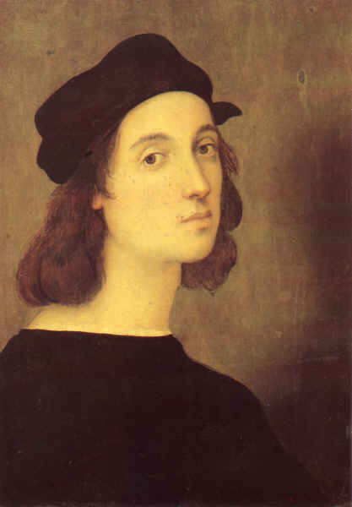
Artists Who Anatomized
Leonardo da Vinci (1452-1519)
Albrecht Dürer (1471-1528)
Michelangelo (1475-1564)
Raphael (1483-1521)
Notes:
http://en.wikipedia.org/wiki/Image:Durer_self_portarit_28.jpg
http://www.library.vanderbilt.edu/speccol/contini_volterra.shtml
http://en.wikipedia.org/wiki/Image:Michelango_Portrait_by_Volterra.jpg
http://library.thinkquest.org/20868/ico/gal/b001.jpg

Slide 15
Da Vinci: Mona Lisa

Slide 16
Leonardo Da Vinci: the Last Supper

Slide 17
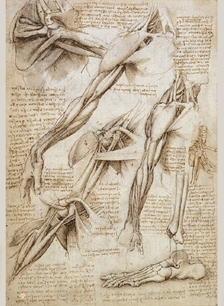
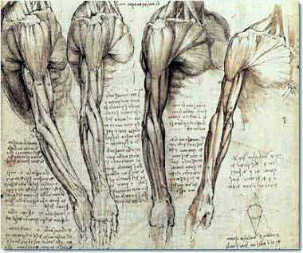
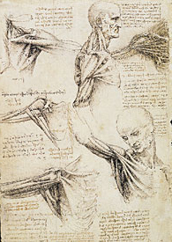
Leonardo da Vinci (1452-1519)
Notes:
http://www.visi.com/~reuteler/leonardo.html c.1489
http://www.royal.gov.uk/output/Page3790.asp

Slide 18
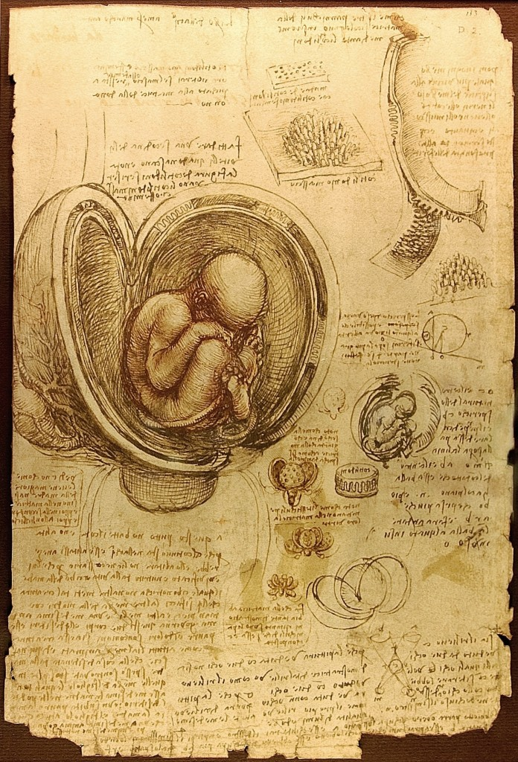

Slide 19
Vitruvian Man

Slide 20
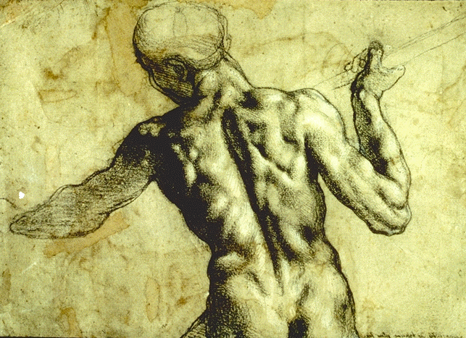
(picture reversed)
Michelangelo (1475-1564)
Notes:
Michelangelo
http://www.mcm.edu/academic/galileo/ars/arsgifs/zmichelangelo.gif

Slide 21
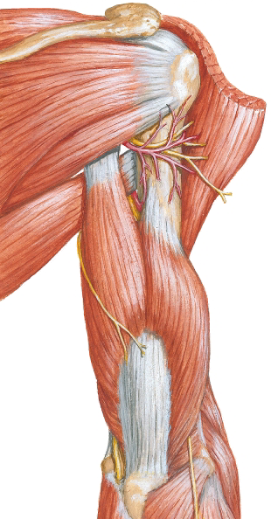
(picture reversed)
Michelangelo (1475-1564)
Notes:
Michelangelo
http://www.mcm.edu/academic/galileo/ars/arsgifs/zmichelangelo.gif

Slide 22
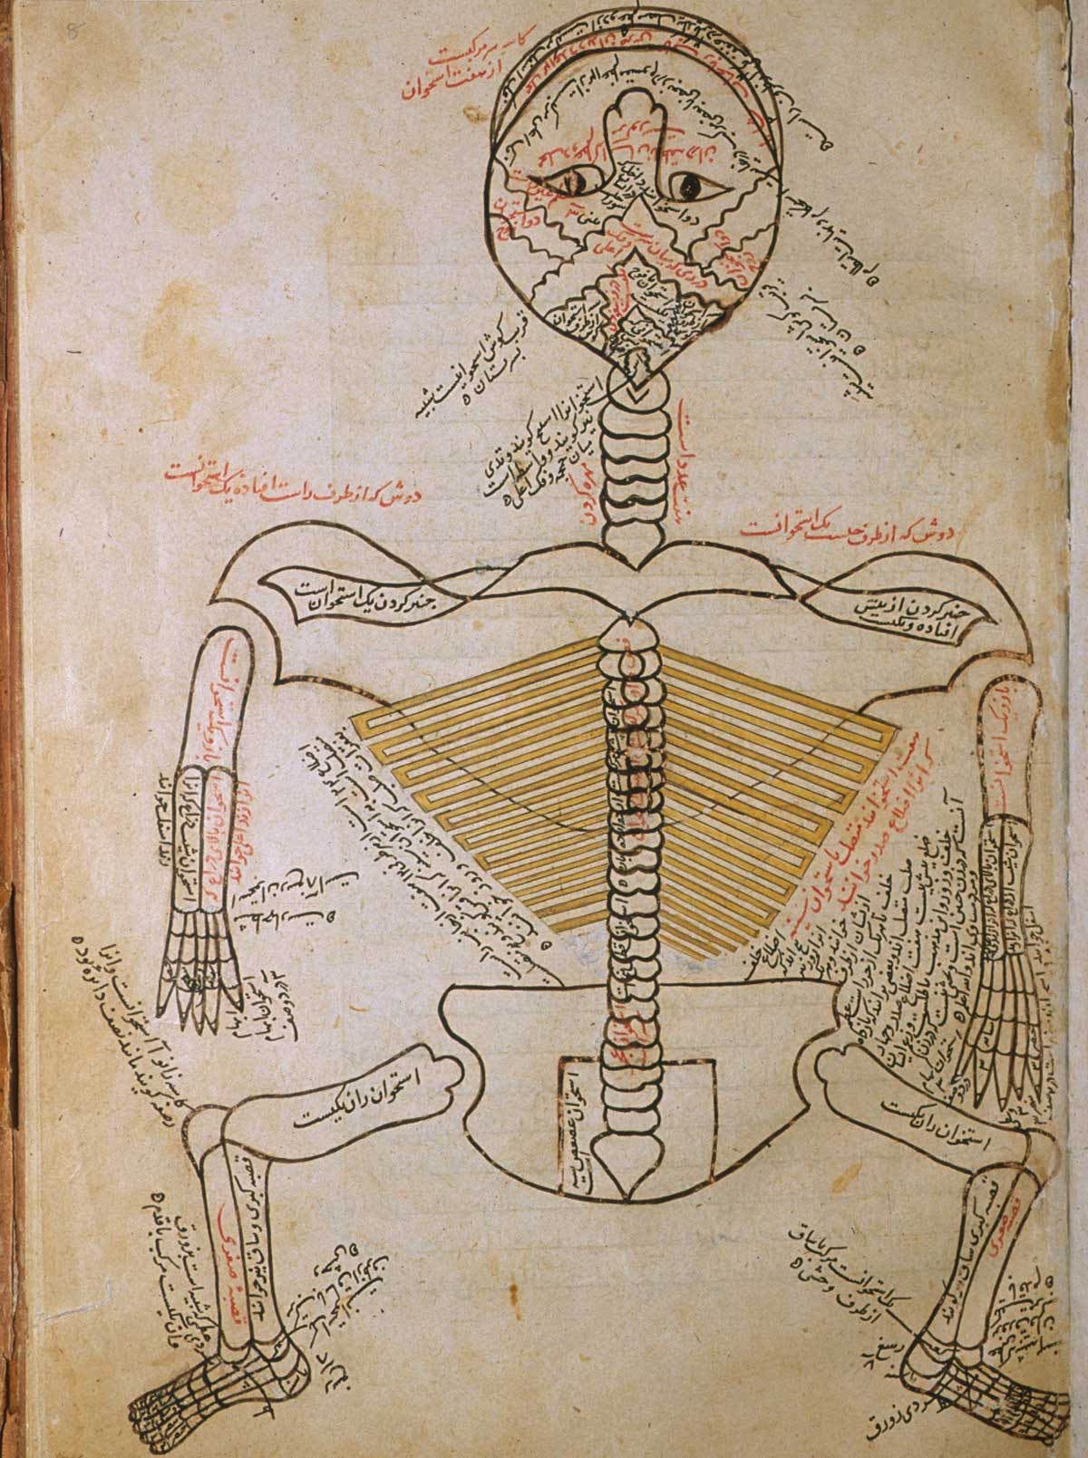
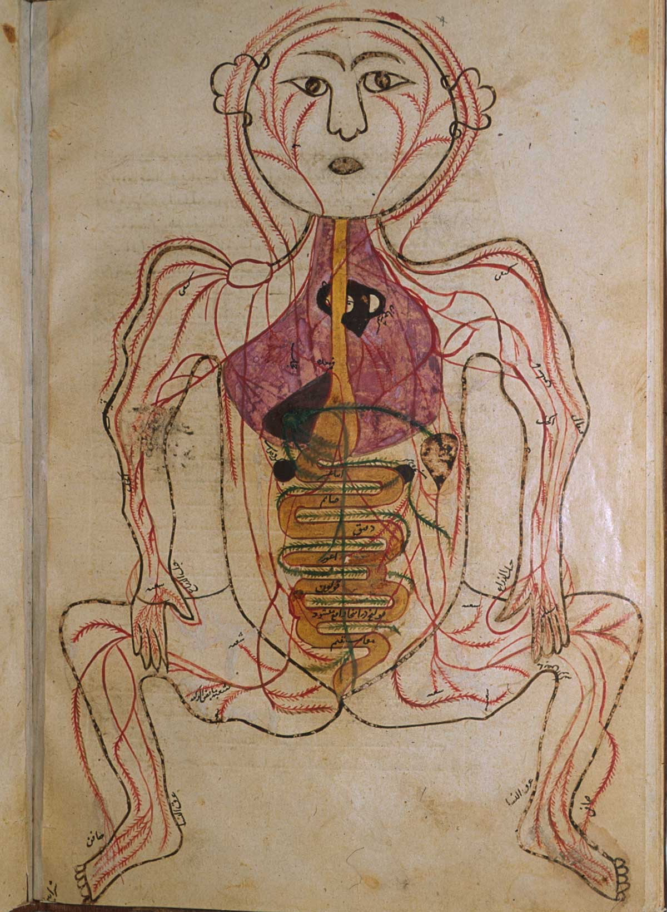
Five Picture Series (c. 1400) bones, nerves, muscles, veins, and arteries
Notes:
http://www.nlm.nih.gov/exhibition/historicalanatomies/Images/1200_pixels/p198a.jpg
http://www.nlm.nih.gov/exhibition/historicalanatomies/Images/1200_pixels/p1916b.jpg

Slide 23
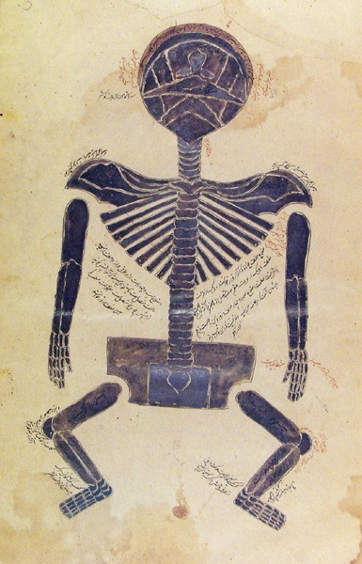
Five Picture Series (c. 1400) bones, nerves, muscles, veins, and arteries
Notes:
Skeleton: Medicine. A Treasury of Art and Literature. Ann G. Carmichael and Richard M. Ratzan. Hugh Lauter Levin Associates, Inc. 1991.
Colorplate 11, p.42
Gravida: Ketham Fasciculo di medicina

Slide 24
Anatomy theaters
University of London 1557
U of Padua in 1594
U of Bologna in 1595
U of Paris in 1617
Oxford in 1623

Slide 25
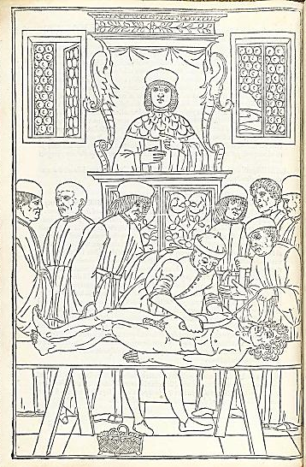
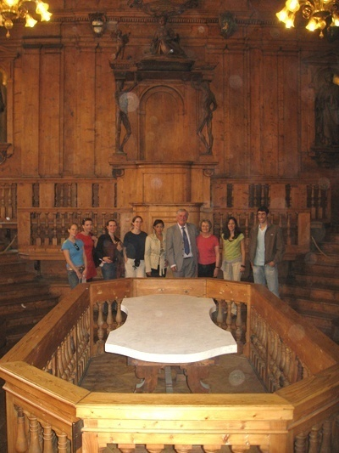
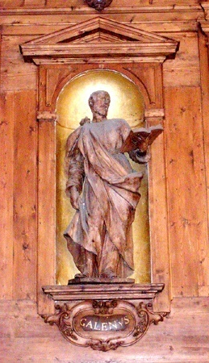
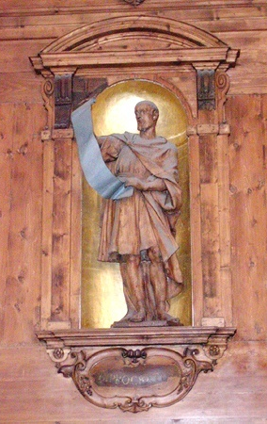
Dissecting Theater (1637) Archiginnasio – Bologna
Notes:
http://www.nlm.nih.gov/exhibition/historicalanatomies/Images/1200_pixels/ketham_p64.jpg
Other photos: Charleen Moore

Slide 26
The Fabrica, title page

Slide 27
Surgical instruments used by Vesalius

Slide 28
Cadaver of an executed person

Slide 29
Skeleton contemplates mortality

Slide 30
The “Muscle Man”

Slide 31
The Muscle Man (posterior)

Slide 32
Anatomy of the jaw

Slide 33
The Inside of the Brain

Slide 34
Ambriose Pare

Slide 35
Galen’s view of blood circulation

